Slide 1

Course Review

Slide 2
Why Should We Learn This Course
The software architecture makes the system analyst's abstraction of software more reasonable and easy to understand.
It helps the stakeholders to have a unified understanding.
It determines the organization activities of developing and maintaining projects.
It is very important for software quality.
Good software architecture is conducive to component reuse.
Good software architecture is conducive to the evolution of software system.
Tips: Remember these statements

Slide 3
Quality of Software
What is Quality Attribute？
A quality attribute (QA) is a measurable or testable property of a system that is used to indicate how well the system satisfies the needs of its stakeholders.
How to express the Quality Attribute
Availability
Interoperability
Modifiability
Performance
Security
Testability
Usability
Tips: Remember the names of these quality attributes

Slide 4
Definitions of some quality attributes
Availability refers to the ability of a system to mask or repair faults such that the cumulative service outage period does not exceed a required value over a specified time interval.
Interoperability is about the degree to which two or more systems can usefully exchange meaningful information via interfaces in a particular context.
Modifiability is the ability to quickly make changes to a system at a higher performance-to-price ratio.
Performance is about time and the software system’s ability to meet timing requirements.
Security is a measure of the system’s ability to protect data and information from unauthorized access while still providing access to people and systems that are authorized.
Testability refers to the ease with which software can be made to demonstrate its faults through (typically execution-based) testing.
Usability is concerned with how easy it is for the user to accomplish a desired task and the kind of user support the system provides

Slide 5
Definition of Software Architecture
According to the definition of Garlan & Shaw’s model, the Software Architecture is defined as a tuple {Components, Connectors, Constraints}
Component can be a set of code, such as program modules, it can be a separate program. Component is a collection of related objects, running to achieve some calculation logic.
Connector can be process calls, pipelines, remote procedure calls, etc., which used to represent the interaction between components, they connect different components to form part of the architecture.
Constraint is generally the rule of the object connection or indicates the condition of the connection of the component. For example, the upper component can require the service of the lower component and vice versa. Two objects must not send messages recursively.
Tips: Remember these definitions

Slide 6
Architecture Styles in this Course
Dataflow System
Batch-Sequential
Pipe-and-Filter
Call-and-Return
Main Program and Subroutines
Object-Oriented
Hierarchical layers
Independent Components
Event-based systems
Virtual machines
Data-Centered-Systems
Blackboard
Model-View-Controller
Client-Server
2-tier C/S
3-tier C/S
Peer-to-peer
Tips: At least you must remember these names

Slide 7
Batch-Sequential and Pipe-and-Filter
Batch-sequential
The batch sequential style is one of the oldest in the design of computer systems. It arose in the early days of data processing when the limitations of computing equipment required that large problems be subdivided into severable components that could communicate by the transfer of magnetic tapes.
Data transformation
tape
validate
tape
sort
tape
Update
tape
Report
report
tape
Data flow

Slide 8
Batch-Sequential and Pipe-and-Filter
Batch Sequential
Processing steps are independent programs
Each step runs to completion before next step starts
Data transmitted as a whole between steps
Because of the above features, there is no need to synchronize its components
Because several components can only be run in sequence and not simultaneously, performance may be worse than programs that run concurrently on several components
Software designed using a sequential batch structure is not suitable for systems that process data in real time

Slide 9
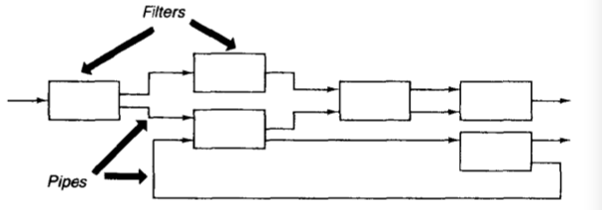
Batch-Sequential and Pipe-and-Filter
Pipe-and-Filter
In a pipe-and-filter style each component has a set of inputs and a set of outputs. This is usually accomplished by applying a local transformation to the input streams and computing incrementally, so that output begins before input is consumed. Hence components are termed filters. The connectors of this style serve as conduits for the streams, transmitting outputs of one filter to inputs of another. Hence the connectors are termed pipes.

Slide 10
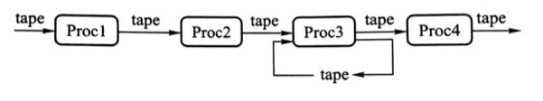
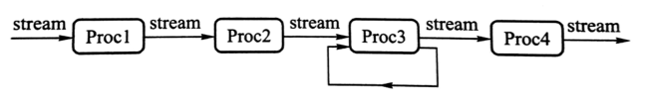
Batch-Sequential and Pipe-and-Filter
Comparison of Batch Sequential and Pipe-and-Filter
Batch Sequential
Pipe-and-Filter

Slide 11
Batch-Sequential and Pipe-and-Filter
Similarity lies in the mutual independence of the processing modules. In batch and pipe-and-filter architectures, the processes are independent of each other, that is, in a batch architecture, each process does not call other processes; in a pipe-and-filter architecture, each filter does not call other filters.
Difference
Data processing is different. In a sequential batch architecture, only the last step is done completely, the next step can start, and the data is transmitted as a block. It is common to have intermediate storage for each intermediate step. In the pipe-and-filter architecture, the filters incrementally transform data in a stream-by-stream manner, with each filter working simultaneously.
The amount of data processed is different. The amount of data processed by the batch sequential architecture is limited, while the amount of data processed by the pipe-and-filter architecture is infinite.
Tips: Remember these differences

Slide 12
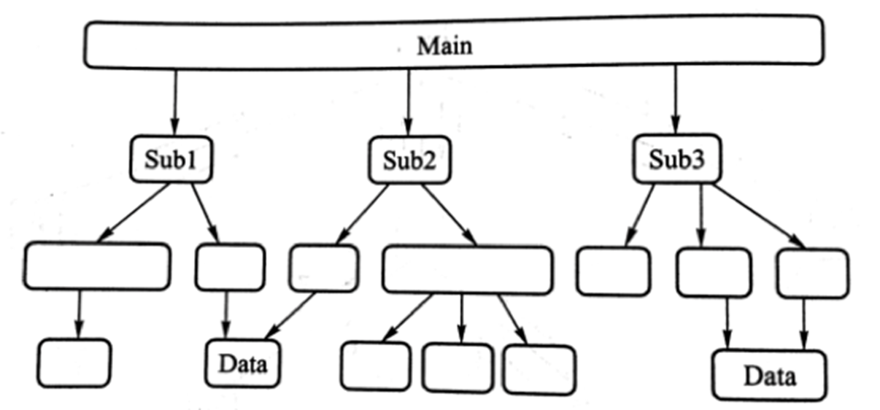
Main Program and Subroutines
Features
The main program and subroutines software architecture uses hierarchical partitioning in design, which uses single control thread directly supported by the programming language.
The structure of the subroutine is clear, and the subroutines usually make up the program module. Subroutine calls appear hierarchical, and its correctness often depends on the correct subroutine call.

Slide 13
Main Program and Subroutines
Methodology
The design philosophy of top-down functional method is that the system is designed from a functional point of view, starting from the top, and gradually refined into a detailed design. The design divides a whole problem into several sub-problems first and then considers each sub-problem to be subdivided into several smaller sub-problems again, and then continues until it can not be further divided.
Structured design begins with the data flow diagram and then transforms it into a program structure diagram.
Usage Scenario
the software is small
functions can be well defined and divided
the requirements seldom change
Tips: Very important!

Slide 14
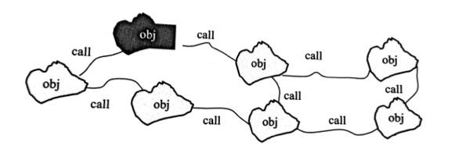
Main Program and Subroutines
Weakness
Functional evolution is difficult
The actual system function is not easy to describe
Functional Design Loses Data and Data Structure
Software products designed by function produce less reusable code
Object-Oriented System Can Solve these Problem, However it also has some weakness
Object-oriented programs occupy large memory.
In order for one object to interact another(via procedure call) it must know the identity of that other object, including the object name, method name and parameter type.
In object-oriented systems, whenever the identity of an object changes it is necessary to modify all other objects that explicitly invoke it.

Slide 15
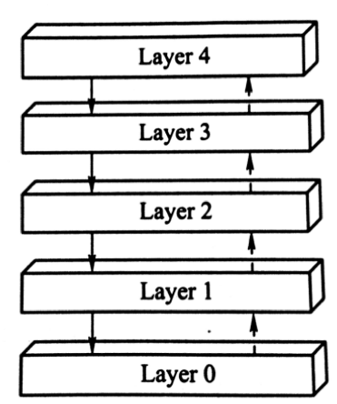
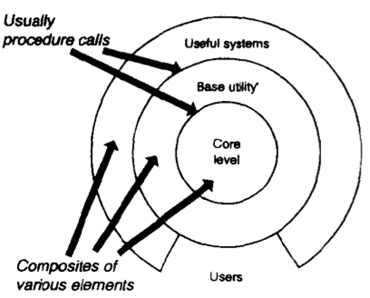
Hierarchical layers
Tips: Remember the name!
Example: network protocol such as TCP/IP
Example: Database

Slide 16
Hierarchical layers
Feature
The call between layers is unidirectional, that is, the class on the n-th layer can call the methods of classes in the n-1 layer, but the class in layer n-1 can not call methods in layer n.
Tips: Remember the Feature!

Slide 17
Hierarchical layers
Feature
Inner layers are hidden from all except the adjacent outer layer, except for certain functions carefully selected for export. Thus in these systems the components implement a virtual machine at some layer in the hierarchy.
Tips: Remember the Feature!

Slide 18
MVC
User interface often changes. For example, the menus need to be reflected when new features are added, different appearance standards exist between different system platforms, the user interface also needs to adapt to the preferences and styles of different users, and even needs to be changed during operation. Moreover, you may need to develop a variety of interfaces for the kernel. Therefore, the user functions obviously can not be closely integrated with the functional kernel.
Model-View-Controller provides a very concise solution.

Slide 19
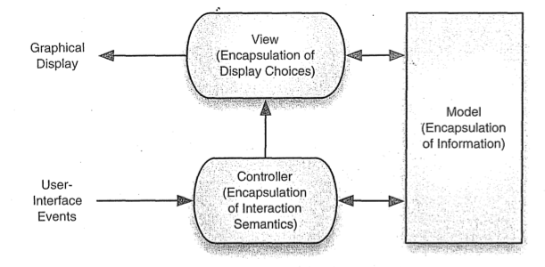
MVC

Slide 20
MVC
View: Display model information for the user. View obtains data from model, a model can correspond to multiple views.
Model: The model is the core of the application. It encapsulates the kernel data and state, and any changes to the model will propagate to all views. All objects that need information from the model must be registered as views of the model
Controller: The controller is an interface that provides users with operations. Each view is associated with a controller. The controller accepts user input, usually from mouse movement, keyboard input, etc. The input event is translated into a service request and sent to the model or view. Users interact with the system only through the controller.

Slide 21
MVC
Advantages
Decomposition of all aspects simplifies the system design and ensures system scalability.
Changes of the interface do not affect the functional kernel of the application, making the system easy to evolve and develop with good maintainability.
It is easy to change and can even change at runtime, providing a good dynamic mechanism.
Disadvantage
Increased complexity of user interface design and implementation
Inefficiency of data access in view

Slide 22
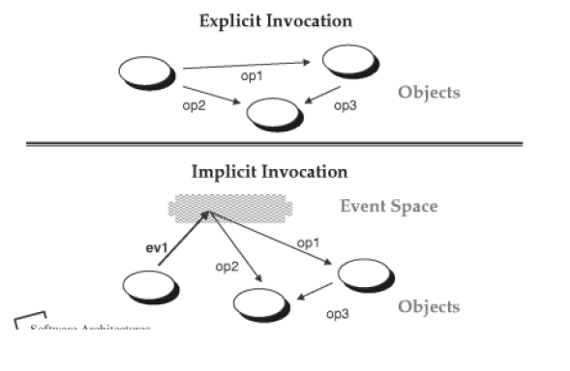
Event-based Systems
This style has historical roots in systems based on actors, constraint satisfaction, daemons, and packet-switched networks, variously referred to as implicit invocation, reactive integration, and selective broadcast.

Slide 23
Event-based Systems
The idea behind implicit invocation is that instead of invoking a procedure directly, a component can announce (or broadcast) one or more events. Other components in the system can register an interest in an event by associating a procedure with it. When the event is announced, the system itself invokes all of the procedures that have been registered for the event. Thus an event announcement “implicitly” causes the invocation of procedures in other modules.
Architecturally speaking, the components in an implicit invocation style are modules whose interfaces provide both a collection of procedures( as with abstract data type) and a set of events. Procedures may be called in the usual way, but a component can also register some of its procedures with events of the system. This will cause these procedures to be invoked when those events are announced at run time.

Slide 24
Event-based Systems
How to make events dispatched to registered components in the system? Need strategies:
System with separate dispatcher module
System without a central dispatcher module
The dispatcher module is responsible for receiving all incoming events and dispatching tem to other modules in the system.

Slide 25
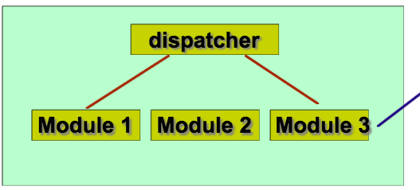
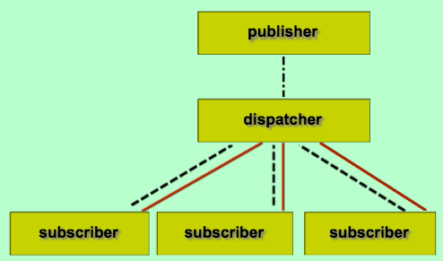
Event-based Systems
All broadcasting
Selected broadcasting
System with separate dispatcher module

Slide 26
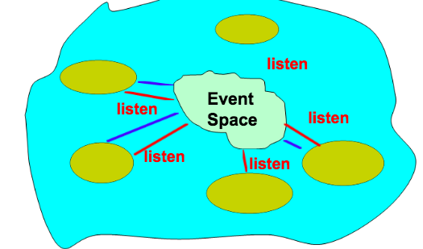
Event-based Systems
System without a separate dispatcher module

Slide 27
Event-based Systems
Advantages
Strong support for reuse
Implicit invocation eases system evolution
Disadvantages
Components relinquish control over the computation performed by the system. When a component announces an event, it cannot assume other components will respond to it.
Sometimes data can be passed with an event, but in other situations event systems must rely on a shared repository for interaction. In this case global performance and resource management can become critical issues.
Reasoning about correctness can be problematic, since the meaning of a procedure that announces events will depend on the context of binding in which it invoked.

Slide 28
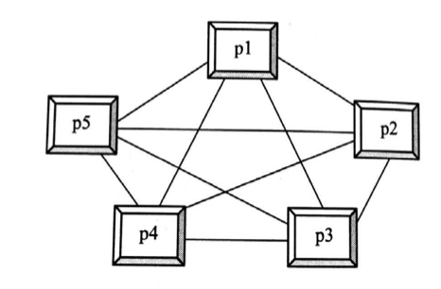
Peer-to-Peer (P2P) Systems
P2P architecture is a non-centralized architecture, that is, there is no server or client concept in the network. In the P2P architecture model, each node in the network is considered as a peer, they have the same status, any one node can request services and provide services, that is, each node is Client, also a Server.
P2P distributed network architecture consists of a large number of participants or peers, each node can provide other participants with services such as processing power, hard disk storage, network bandwidth, etc. Each participant interacts directly with each other without the need for an intermediary web server. Each node is the provider of resources, but also the consumers of resources.

Slide 29
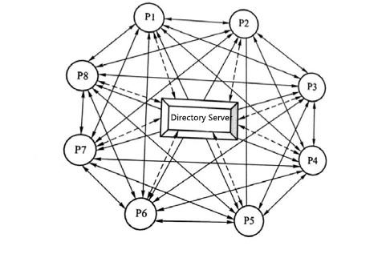
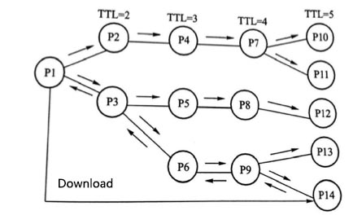
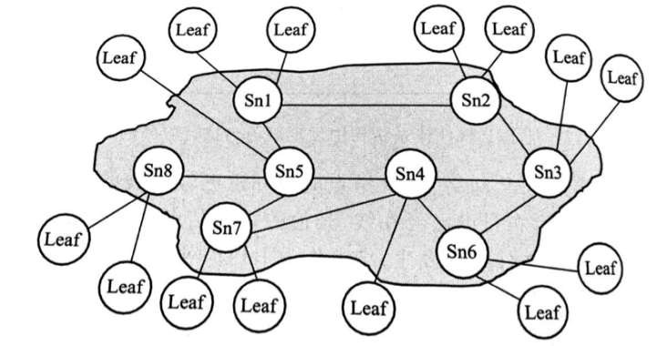
Peer-to-Peer (P2P) Systems
Centralized P2P—The 1st generation of P2P software architecture
A centralized directory-based P2P software architecture uses a central directory server to manage P2P nodes.
Pure P2P—The 2nd generation of P2P software architecture
Pure P2P architecture is also known as broadcast P2P model
Unstructured hierarchical Pure P2P—The 3rd generation of P2P software architecture
By dividing the peer into two categories: super-node and leaf-node, the super-node is formed into an overlay network based on the original peer-to-peer network.

Slide 30
Design Patterns in this Course
Creational Patterns
Simple Factory
Factory Method
Abstract Factory
Builder
Singleton
Structure Patterns
Adaptor
Composite
Bridge
Façade
Behavioral Patterns
Iterator
Mediator
Observer
Strategy
Tips: Remember the names of these design patterns.

Slide 31
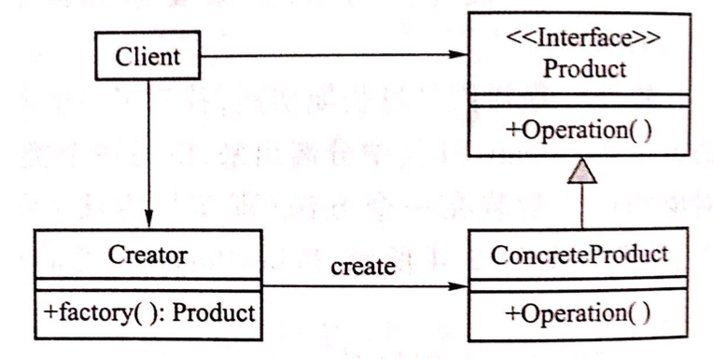
Simple Factory
Simple factory class diagram
The Creator class is a factory class. The class in the right half of the figure is called the product class and consists of the interface Product and concrete product class ConcreteProduct.

Slide 32
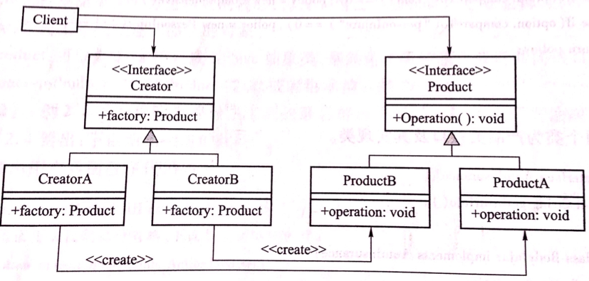
Factory Method
Class diagram of Factory Method
Rewrite a single factory class in a simple factory method schema to a hierarchical class. First you need an interface as a superclass called creator. There is a method in the interface called factory(); then you can use the same structure as the product class to create the creator class structure, which contains creatorA and creatorB, each responsible for creating the corresponding ProductA And ProductB objects. Each product class corresponds to a factory class. The factory class is only responsible for creating the corresponding product class object.

Slide 33
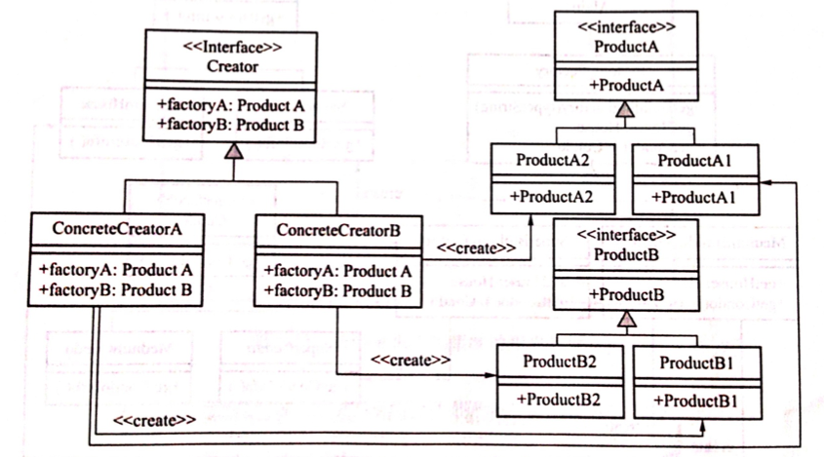
Abstract Factory
bstract factory pattern design class diagram - two product categories
The Abstract Factory Pattern contains two product class abstract factory pattern design class

Slide 34
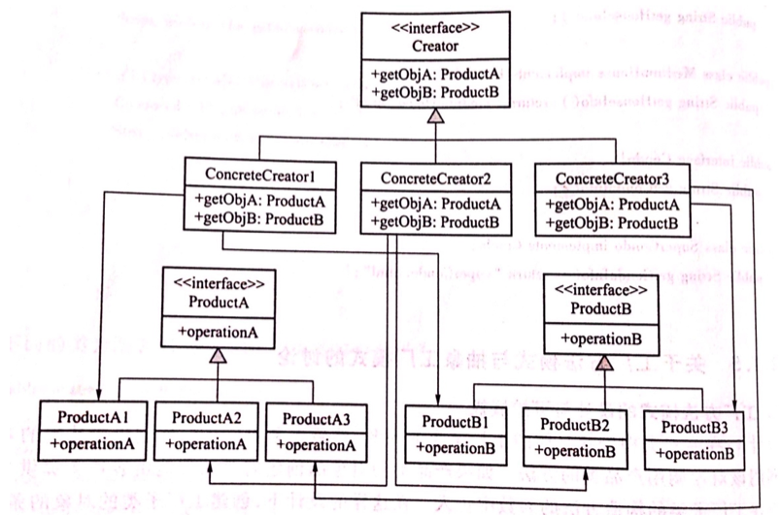
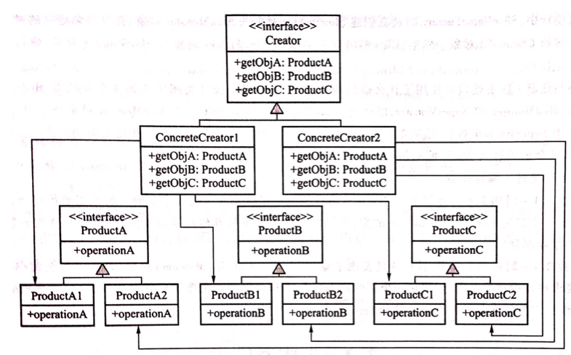
Abstract Factory
If you need to increase ProductA3 and ProductB3, the factory class needs to increase the class ConcreteCreator3.
If you want to add a new product hierarchy class, ProductC, you must add a method to each factory real class. +getObjC.

Slide 35
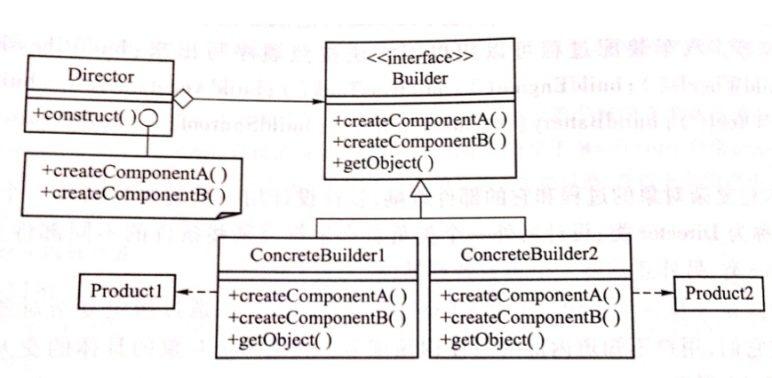
Builder
Builder pattern separates the construction of a complex object from its representation so that the same construction process can create different representation.

Slide 36
Singleton
Intent
Ensure a class only has one instance, and provide a global point of access to it.
Motivation
It is important for some classes to have exactly one instance. Although there can be many printers in a system, there should be only one printer spooler. There should be only one file system and one window manager.
Solution
Make the class itself responsible for keeping track of its sole instance. The class can ensure that no other instance can be created (by intercepting requests to create new objects), and it can provide a way to access the instance.

Slide 37
Singleton
Declare a constructor as a private type, and other types cannot use this constructor to create an object.
Provide a getInstance method that can get an instance. This method is a static method that ensures that the client gets the same object at all times.
Public class Singleton {
private static Singleton instance;
private String name;
private Singleton (String name) {
this.name = name;
}
public static Singleton getInstance (String name) {
if (instance == null && ! name.equals(null))
instance = new Singleton (name);
return instance;
}
}
Tips: Remember these Keywords!

Slide 38
Singleton
Tips: This problem is very important!
Singleton Pattern must be used carefully in multithreaded applications. If two threads simultaneously call the create method when the only instance has not yet been created, it will cause each of the two threads to create an instance of the same, thereby violating the original intention of the uniqueness of the singleton pattern. In order to improve the above design, the getInstance() method in the design can be declared as synchronized.
public static Singleton getInstance() {
if (singleton == null) {
synchronized (Singleton.class) {
if (singleton == null) {
singleton = new Singleton();
}
}
}
return singleton;
}

Slide 39
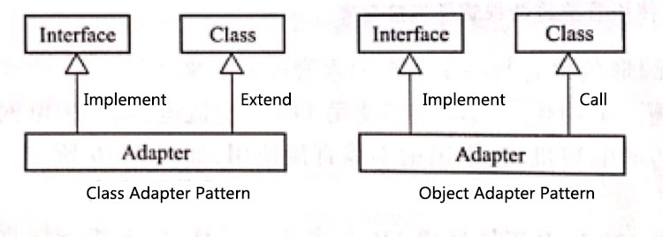
Adaptor
In software design, in order to solve the interface inconsistency problem, two software modules often need to be “adapted” through an Adapter class. This pattern is called adapter design pattern.
This pattern can be divided into two types, namely Class Adapter Pattern and Object Adapter Pattern

Slide 40
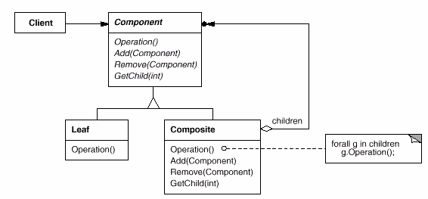
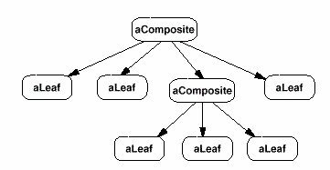
Composite
Compose objects into tree structures to represent part-whole hierarchies.
Composite lets clients treat individual objects and compositions of objects uniformly.

Slide 41
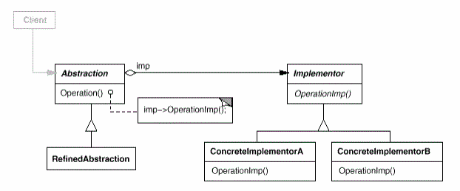
Bridge
Indent
Decouple an abstraction from its implementation so that the two can vary independently.
Structure

Slide 42
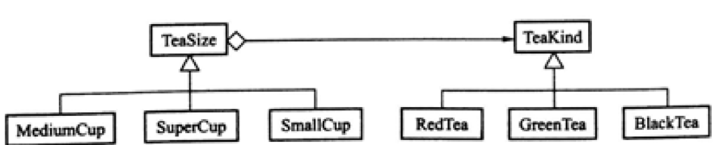
Bridge-Example
when there are several dimensions in the designed program, the design that separates the abstract part from the implementation part can make the program independent and add classes without affecting each other. And there is no need to change or even recompile already existing classes.

Slide 43
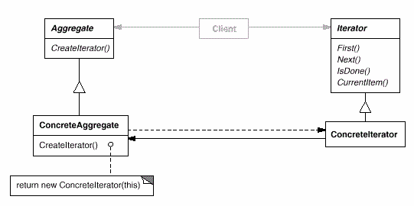
Iterator
The key idea of iterator pattern is to separate the access and traversal of the list from the list object into a separate iteration object.
Intent
Provide a way to access the elements of an aggregate object sequentially without exposing its underlying representation.
Structure

Slide 44
Iterator-Example (C++)
Class StudentManagement {
private:
vector<int> ids;
list<int> scores;
public:
void traversal () {
vector<int>::iterator id_iter = ids.begin();
list<int>::iterator score_iter = scores.begin();
for (; id_iter != ids.end(); id_iter++)
visit(*id_iter)
for (; score_iter != scores.end(); score_iter++)
visit(*score_iter)
}
Tips: Remember this example

Slide 45
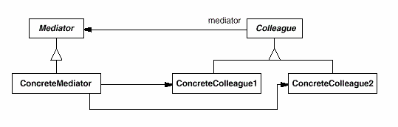
Mediator
Participants
Mediator
Defines an interface for communicating with Colleague objects.
ConcreteMediator
Implements cooperative behavior by coordinating Colleague objects
Knows and maintains its colleagues
Colleague classes
Each Colleague class knows its Mediator object
Each colleague communicates with its mediator whenever it would have otherwise communicated with another colleague.
Structure

Slide 46
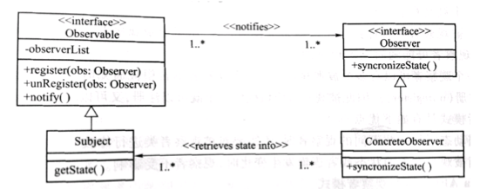
Observer
Intent
Define a one-to-many dependency between objects so that when one object changes state, all its dependents are notified automatically.
Structure

Slide 47
Observer
The observer pattern works as follows:
The Subject maintains a data structure, such as a Java ArrayList, for recording dynamically added observers.
The object interested in the state of the Subject(observer) should call the Subject 's Register method to register itself as an observer of it.
Whenever the state of the Subject changes, it will notify the registered observer using the method notifyObservers().
When notified, each observer will check the state of the Subject to keep the state synchronized. According to the new state, the observer will decide to do some synchronous updates or other related operations.
The observer will provide an interface that receives notification from the subject, such as synchronizeState(), which the subject can invoke in the method notify().

Slide 48
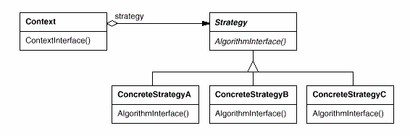
Strategy
Intent
Define a family of algorithm, encapsulate each one, and make them interchangeable. Strategy lets the algorithm vary independently from clients that use it.
Structure

Slide 49
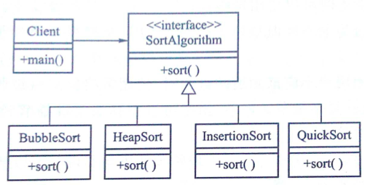
Strategy-Example
Advantages: Modifying an algorithm only requires recompiling the class involved in the algorithm without having to recompile other classes. If you want to add a new algorithm, you only need to add a new class that encapsulates the algorithm in the collection of subclasses.

Slide 50
Thank YOU! GOOD luck!
Not all contents will appear in the final examination
BUT all questions in examination are in this PPT!

